Slide 1

AI-Powered Trading Edge
Sean Wong
2025/01/01

Slide 2

CONTENTS
01
AI Trading Landscape
02
Signal Generation
03
Backtest & Optimize
04
Risk Management
05
Execution Automation
06
Reporting Analytics

Slide 3
CONTENTS
01
Hands-On Workshop
02
Adoption Playbook

Slide 4

01
AI Trading Landscape

Slide 5

AI Already Trades Beside You
AI in Trading Today
AI is already integrated into trading workflows, helping traders detect signals, manage risk, and generate insights faster than ever before. It processes vast amounts of data in milliseconds, providing a significant edge in today's fast-paced markets.
Speed and Efficiency
Augmenting Human Traders
AI algorithms can analyze market data, execute trades, and monitor portfolios in real-time, reducing manual effort and freeing traders to focus on strategic decision-making and risk oversight.
While AI automates repetitive tasks, it augments human traders by providing deeper insights, faster analysis, and improved risk management, ensuring that traders remain central to strategic decisions.

Slide 6

Human-AI Division of Labor
AI's Role
AI excels at data processing, pattern recognition, and repetitive tasks, handling market data analysis, signal detection, and portfolio monitoring with high precision and speed.
Human Traders' Role
Traders retain control over strategic decisions, risk management, and ethical judgment, leveraging AI insights to make informed trades and maintain compliance with regulatory standards.

Slide 7
02
Signal Generation

Slide 8
AI Spots Micro-Patterns Instantly
Real-Time Data Analysis
Automated Signal Detection
AI tools like TradingView AI and Bloomberg monitor tick-level data to identify breakout levels, momentum divergences, and liquidity gaps, providing actionable trade ideas in real-time.
AI algorithms can detect trading signals and anomalies within seconds, offering ranked trade ideas with entry, stop, and target levels to enhance trading efficiency.
Enhanced Market Insights
Sentiment Analysis
By analyzing vast amounts of market data, AI provides deeper insights into price trends, volumes, and technical indicators, helping traders make more informed decisions.
AI performs sentiment analysis on news and social media, identifying bullish or bearish trends that precede volatility spikes, enabling traders to react faster to market-moving events.

Slide 9
Sentiment Scrapes Edge from News
Sentiment Analysis Tools
Tools like Accern and Dataminr parse real-time news and social media, quantifying sentiment scores to help traders capitalize on market sentiment and avoid emotional biases.

Slide 10
03
Backtest & Optimize

Slide 11
AI Backtests Millions of Paths
Iterative Strategy Refinement
AI enables traders to quickly iterate and refine strategies, turning weeks of manual coding into an afternoon of productive optimization and analysis.
Rapid Backtesting
AI platforms like QuantConnect and MetaTrader run backtests on historical data within minutes, evaluating performance metrics and suggesting optimal strategy parameters.

Slide 12
Walk-Forward Avoids Overfit
Data Segmentation
AI engines segment data into training, validation, and test sets, applying rolling windows to ensure robust performance metrics and avoid overfitting.
01
Robust Performance Metrics
02
By simulating various market conditions, AI provides reliable performance metrics that translate from historical data to live trading environments.
Preventing Curve-Fitting
AI helps traders avoid the pitfalls of curve-fitting by ensuring that strategies are tested against unseen data and real-world market volatility.
03

Slide 13
04
Risk Management

Slide 14


AI Sizes Exposure Dynamically
Dynamic Risk Adjustment
AI tools like BlackRock Aladdin and Riskfolio dynamically adjust portfolio exposure, ensuring that position sizes remain within risk limits during market volatility.

Slide 15
Stress Tests Run Instantly
Risk Oversight
Tail-Risk VaR Calculation
Instant Stress Testing
Hedge Ratio Optimization
AI provides continuous risk oversight, flagging unusual exposure or over-concentration, and ensuring compliance with regulatory standards.
AI calculates tail-risk Value at Risk (VaR) in real-time, helping traders manage extreme market risks and maintain portfolio resilience.
AI can simulate extreme market scenarios like 2008 or COVID crashes, estimating potential drawdowns and providing pre-loaded contingency plans for traders.
AI suggests optimal hedge ratios based on simulated stress scenarios, ensuring that traders are prepared for sudden market moves.

Slide 16
05
Execution Automation

Slide 17

Optimized Order Execution
AI-powered order routing minimizes market impact and captures spread rebates, achieving better execution prices and reducing slippage.
Algorithmic Trading
Smart Order Routing Cuts Slippage
AI-driven trading bots execute complex strategies with precision, timing trades to optimize performance and maintain discipline.
Compliance Monitoring
AI ensures compliance with trading rules and regulations, providing audit trails and real-time monitoring to prevent violations.

Slide 18
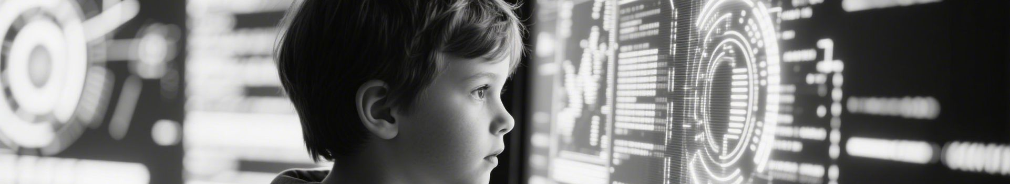

Bots Enforce Rule-Based Discipline
Automated Trade Execution
AI bots execute trades based on predefined rules, ensuring consistent strategy execution without emotional interference.
24/5 Monitoring
AI monitors markets around the clock, executing trades and logging data for audit trails, providing continuous oversight and execution.

Slide 19
06
Reporting Analytics

Slide 20
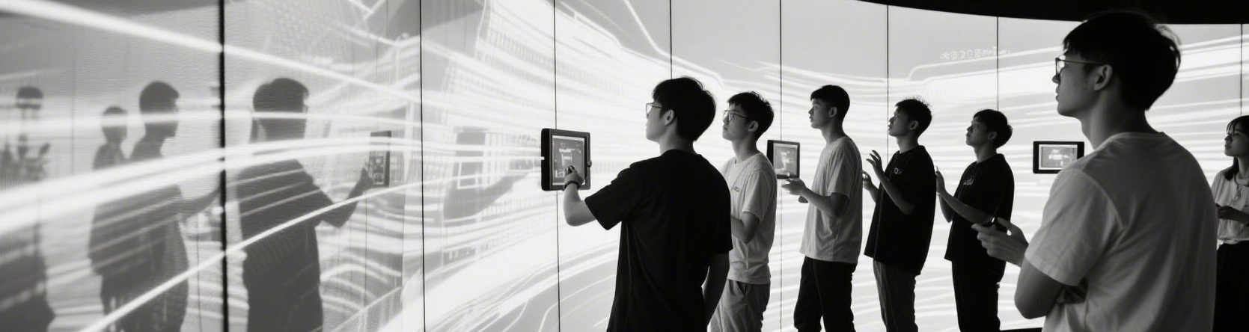
AI Drafts Daily P&L Summaries
Automated Reporting
AI tools like Excel Copilot and Tableau generate daily P&L summaries, visual dashboards, and performance metrics, saving traders time and reducing errors.

Slide 21
Attribution Flags Edge Sources
02
01
03
Investor-Ready Reports
AI generates annotated charts and explanatory commentary, delivering investor-ready reports within minutes of market close.
Performance Attribution
Risk-Adjusted Performance
AI decomposes returns into factor exposures, sector tilts, and timing contributions, identifying genuine sources of alpha and eliminating lucky drift.
AI provides risk-adjusted performance metrics, helping traders optimize allocations and maintain disciplined risk management.

Slide 22
07
Hands-On Workshop

Slide 23
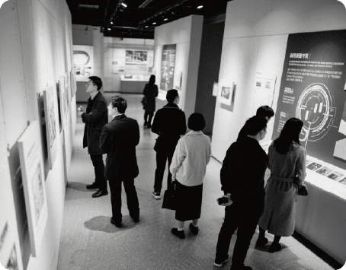
Task Triage Matrix Exercise
Identify AI Candidates
Traders list daily workflows and score them on repetition, data load, and time sensitivity, identifying high-score tasks as prime candidates for AI integration.
Focus on Efficiency Gains
By focusing on tasks where speed gains and error reduction are significant, traders can prioritize AI adoption for maximum impact.

Slide 24

Live Signal Hunt Simulation
Real-Time Signal Detection
Experience Machine Assistance
Using sample intraday data, traders apply AI screeners to detect breakout candidates and validate signals against news sentiment.
Participants experience how AI compresses research time while maintaining the need for human validation and decision-making.
Entry Plan Presentation
Practice Rapid Iteration
Traders present entry plans based on AI-detected signals, discussing position sizing and execution timing with human judgment.
Traders practice rapid iteration by refining signals and strategies based on real-time feedback from AI tools.

Slide 25
Backtest Relay Race
“
Rapid Strategy Optimization
Participants feed trading strategies into AI engines, receive performance metrics and suggested parameter tweaks, and debate robustness versus overfitting.
“

Slide 26
08
Adoption Playbook

Slide 27
Quick Reference Guide
A one-page cheat sheet maps trading phases to AI tools, providing a quick reference for traders to integrate AI into their workflows.
Human Checkpoints
One-Page Trader AI Cheat Sheet
The cheat sheet emphasizes human checkpoints for validating signals, maintaining discipline, and ensuring compliance before capital deployment.
Tool Selection
The guide helps traders select the right AI tools for each phase, preventing tool sprawl and ensuring alignment with trading strategies.

Slide 28


Ethical & Compliance Checklist
Model Transparency
Regulatory Alignment
Verify model transparency, audit logs, and market-manipulation safeguards to ensure ethical use of AI in trading.
Align AI tools with exchange rules and risk mandates to protect investor capital and avoid regulatory violations.

Slide 29
Pilot-to-Scale Roadmap
01
02
03
04
Start with a Pilot
Expand to Risk Management
Continuous Improvement
Maintain Human Oversight
Begin with a single repetitive task, define baseline metrics, and run a four-week pilot with limited capital to measure speed and accuracy gains.
After the pilot, expand AI to risk management and reporting while embedding continuous model validation and human oversight.
Use AI to continuously improve trading strategies, ensuring robust performance metrics and alignment with market conditions.
Ensure human traders maintain oversight and control, leveraging AI insights to make informed decisions and manage risk.

Slide 30

THANK
YOU
Sean Wong
2025/01/01

